Slide 1
Process Management

Slide 2
Processes
Computers can do several tasks at once
  Multiprogramming
  Multiple programs can be loaded into memory and executed concurrently
    On a single processor, the execution of multiple processes can be interleaved in time.
    on a multiprocessor (or multi-core), not only may process execution be interleaved, but also multiple processes can execute simultaneously.
  CPU “switches” between programs very often
  pseudoparallelism vs. true parallelism
Notes:
e.g. multiple processes running concurrently e.g. printing a document, playing a music file, searching for a file on the hard drive, waiting for a file to download from the web, editing a word document etc

Slide 3
A process is a program in execution and includes:
  program counter and registers (in CPU)
  Program code (text section)
  data section: for global variables
  Stack: contains temporary data (method parameters, return addresses, local variables)
  Heap – contains dynamically allocated memory
Notes:
Stack – has one frame for each procedure/method. See Tanenbaum P.101.

Slide 4

Memory for a process
Notes:
For our purposes, memory for a process consists of
program code (text) and
data section

Slide 5
Process vs Program
A program is just a set of instructions expressed in some suitable notation but is static – often called an executable file
A process is dynamic and is the execution of this set of instructions
Some processes are OS processes – others are user processes
A CPU is shared among several processes with an OS scheduling algorithm used to determine when to stop work on one and service a different one.
Notes:
Note: the same program can be run multiple times to generate multiple processes e.g. run Notepad.exe multiple times

Slide 6
A program becomes a process when an executable file is loaded into memory
e.g. double clicking on an icon representing an executable file will run it

Slide 7
Scheduler and Dispatcher
Scheduler – (CPU scheduler or short-term scheduler) selects from among the processes that are ready to execute and allocates the CPU to one of them
Dispatcher is the module that gives control to the process selected by the scheduler

Slide 8
Trace of the Process
The behavior of an individual process is shown by listing the sequence of instructions that are executed
This list is called a Trace
Dispatcher is a small program which switches the processor from one process to another (Scheduler is also involved here – so could say Scheduler and Dispatcher instead of just Dispatcher)

Slide 9
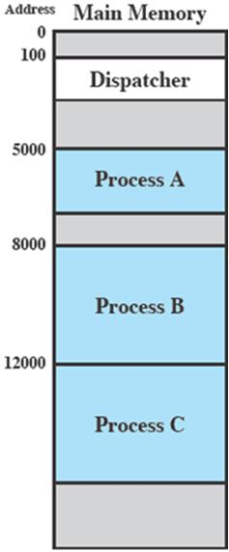
Process Execution
Consider three processes being executed
All are in memory (plus the dispatcher)
Lets ignore virtual memory for this.

Slide 10
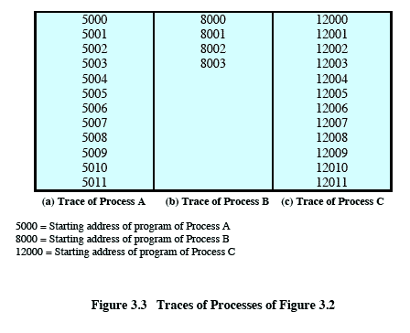
Trace from the processes point of view:
Each process runs to completion
Notes:
Animated slide
Wipes down to give impression of process progression

Slide 11
Trace from Processors point of view
Assume that the OS only allows a process to continue execution for a maximum of six instruction cycles, after which it is interrupted; this prevents any single process from monopolizing processor time.
Assume processes are queued in the order A, B, C,
The first six instructions of process A are executed, followed by a time-out and the execution of some code in the dispatcher, which executes six instructions before turning control to process B2.
After four instructions are executed, process B requests an I/O action for which it must wait. Therefore, the processor stops executing process B and moves on, via the dispatcher, to process C.
After a time-out, the processor moves back to process A. When this process times out, process B is still waiting for the I/O operation to complete, so the dispatcher moves on to process C again.

Slide 12
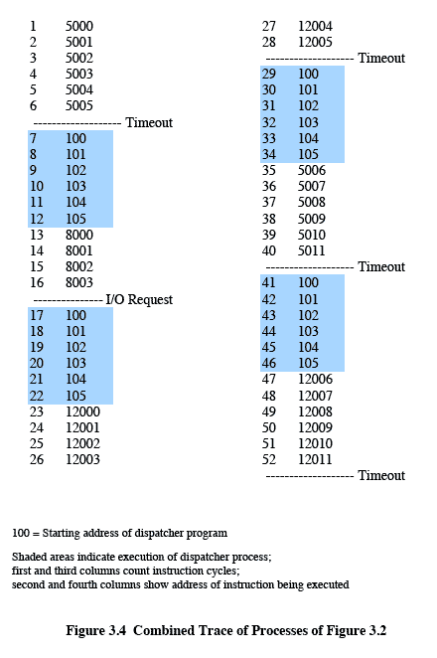
Trace from Processors point of view
Timeout
Timeout
Timeout
I/O
Notes:
Note: round-robin scheduling is used here
Quantum is 6 instruction cycles

Slide 13
Process Creation
Once the OS decides to create a new process it:
  Assigns a unique process identifier
  Allocates memory space for the process
  Initializes process control block

Slide 14
Process Creation
Upon process creation a new window is often opened and so many windows running many processes often exist
  using mouse user selects window to interact with process

Slide 15
As a process executes, it changes state
A process can be in one of the following states
  new: The process is being created
  running: Instructions are being executed by the CPU
  blocked: The process is blocked while waiting for some event to occur e.g. I/O completion
  ready: runnable but OS has allocated CPU to another process
  terminated: The process has finished execution
N.B. Only one process can be running on a processor at any instant
Notes:
In Task Manager all processes have status running – cannot differentiate between different states of a process
In Swing in Java, the event dispatch thread has a loop:
while the program is still running:
wait for the next event to occur
call a method to handle the event

Slide 16

Process state transitions
Terminated
New
Notes:
Look again at process trace and consider process states and process state transitions

Slide 17
Transition 1 occurs when a running process cannot continue because it’s waiting for some event to occur e.g. input from keyboard or output to disk
When the character has been typed or the disk written to, the blocked process is unblocked and is eligible to run again – transition 4
Transition 2 and 3 occur when the scheduler decides to change which process is running
Transition 2 can also occur due to an interrupt
Notes:
A clock interrupt will cause Transition 2 when current process has had its quantum of time with round robin scheduling

Slide 18
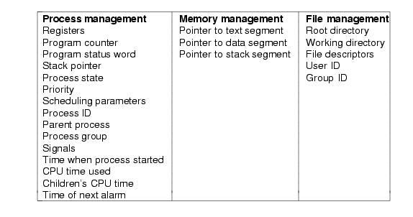
Process Implementation
OS has a process table - 1 entry per process – entries sometimes called process control block - PCB
Actual process table entries
are system dependent
Notes:
Memory Management:
Each time a process is given control of CPU, the memory management hardware must be configured so that only the memory locations allocated to that process may be accessed
Memory management may include pointer to page table that describe the virtual memory for this process

Slide 19
Process scheduler
Objective of multiprogramming is to have some process running at all times to maximise CPU utilisation
The scheduler (part of OS) selects a process from those available for execution on the CPU
Will look at scheduling algorithms later

Slide 20

CPU Switch From Process to Process
Notes:
Here scheduler selects which process should be executed next (e.g. P₁ ) and allocates CPU

Slide 21
Process Scheduling Queues
Job queue – set of all processes in the system
Ready queue – set of all processes residing in main memory, ready and waiting to execute
Device queues – set of processes waiting for an I/O device
Processes migrate among the various queues

Slide 22

Ready Queue And Various I/O Device Queues

Slide 23
Modes of Execution
Most processors support at least two modes of execution
  User mode
  Kernel mode
Notes:
Certain instructions can only be executed in the kernel mode.
Including reading or altering a control register, such as the program status word;
primitive I/O instructions;
Instructions that relate to memory management.
In addition, certain regions of memory can only be accessed in the more-privileged mode.

Slide 24
How does the processor know in which mode it is to be executing? And how does it change?
  Typically a flag (single bit) in the program status word (PSW). This bit is changed in response to certain events.
  Typically, when a user makes a call to an operating system service or when an interrupt triggers execution of an operating system routine, the mode is set to the kernel mode and, upon return from the service to the user process, the mode is set to user mode.

Slide 25
Context Switch
Performed by the Dispatcher
A context switch occurs when the OS has gained control from the currently running process
The OS must then save the state of the old process and load the saved state for the new process via a context switch
Context of a process represented in the PCB
Notes:
Process state is saved so that it can be later resumed

Slide 26
Context Switch
Context-switch time is overhead; the system does no useful work while switching
Time dependent on hardware support – typically a few milliseconds

Slide 27
Context Switch
The steps in a context switch:
  Save context of processor including program counter and other registers
  Update the process control block of the process that is currently in the Running state – includes changing its state to Ready or Blocked
  Move process control block to appropriate queue – ready; blocked;

Slide 28
Context Switch
Select another process for execution
Update the process control block of the process selected – includes changing state of process to Running
Update memory-management data structures
Restore context of the selected process by loading in previous values of the program counter and other registers

Slide 29
Schedulers
Long-term scheduler (or job scheduler) – selects which processes should be brought into the ready queue – usually in batch systems (main frames)
Short-term scheduler (or CPU scheduler) – selects which process should be executed next and allocates CPU

